Slide 1
Title: Predicting Real Estate Prices Using NLP
Subtitle: A Study on the Impact Description on Property Valuation; a
Case of India
Authors: Jawad Bakhteiary & Elizaveta Gavshina

Slide 2
Introduction
Prediction of estate prices is a relevant topic for stakeholders, government, and households.
Different approaches to estimating and predicting estate prices exist based on macroeconomic, geographic, and property-specific factors.
Increasing overvalued estate prices have led researchers to expand the number of factors they take into account, including the use of text mining models.
Real estate classifieds are becoming an interesting source for the analysis of prices over the estate market.
In this study, we focus on analyzing classifieds to predict real estate prices and find out keywords that could affect prices.
We will use data from a scrapped dataset as the biggest source of classifieds for renting and buying apartments, houses, and business properties in India.

Slide 3
Research Question:
Which keywords could affect the prices of real estate positively or negatively?

Slide 4
House Price
House prices are the amount of money paid for a residential property and are influenced by location, size, condition, and other factors.
Research on house prices is essential for informed decision-making by buyers and sellers.
House price research is also critical for policymakers to develop policies to address issues such as affordable housing and property tax rates.
House price data can be used by researchers to study the broader economy, as the housing market is often a leading indicator of economic growth or recession.
Understanding the dynamics of the property market and its impact on individuals, communities, and the economy as a whole is crucial for effective decision-making.

Slide 5
Use of NLP in Forecast of House Price
Text classification using NLP can categorize real estate listings based on property features for predicting house prices.
NLP allows us to extract relevant information from unstructured real estate data and convert it into numerical data for predictive modeling.
NLP techniques such as sentiment analysis and topic modeling can help identify patterns and trends in the real estate market that can lead to more accurate predictions and investment opportunities.

Slide 6
The importance of Indian city
Reason 1
Reason 2
Reason 3
Studying real estate prices in India is crucial for investors, developers, and policymakers to make informed decisions about investments, development projects, and regulatory policies.
India's large and rapidly growing population, economic growth, and growing middle class has led to a huge demand for housing, commercial spaces, and other real estate assets.
India has a diverse range of cities and regions, each with its own unique real estate market, making it an attractive target for studying real estate prices.

Slide 7
What do other authors think?
1 - Location;
access to transportation
desirability of the area
2 - Size:
3 - Economy

Slide 8
Data Collection
Kaggle
14000 observations
Name: Property Name, Property Title: Property Ad Title, Price: Property Price
Location: Property Located Locality and Region Total Area: Total SQFT of the property Price Per SQFT: Price of Per SQFT of the property
Description: Small paragraph about the property Baths: Number of baths in the property Balcony: Whether the Property has balcony or not

Slide 9
The pipeline
1)Data collection: parse/download the data from property sales
2)Preprocessing data (cleaning, tokenization, etc.)
3)Build bag-of-words preparation
4)Create models

Slide 10
1)Data collection
First, we tried to parse data from the russian estate property websites, but the websites are protected by CAPTCHA-chekings
Then we took the data from Kaggle-website (~14 000 ads of Indian properties)
The initial dataset consists of 9 columns and ~14000 columns
The variables used: price per sqm, description of the ad

Slide 11
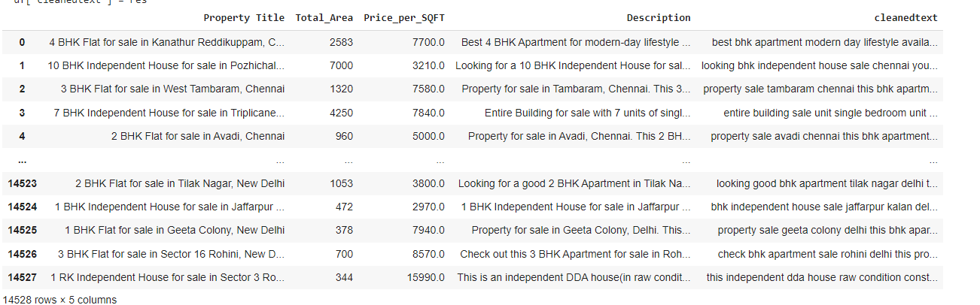
2)Data preprocessing
1)Getting rid of punctuation and numbers
2)Tokenization
3)Lemmatization and stemming
4)Converting to lower cases

Slide 12
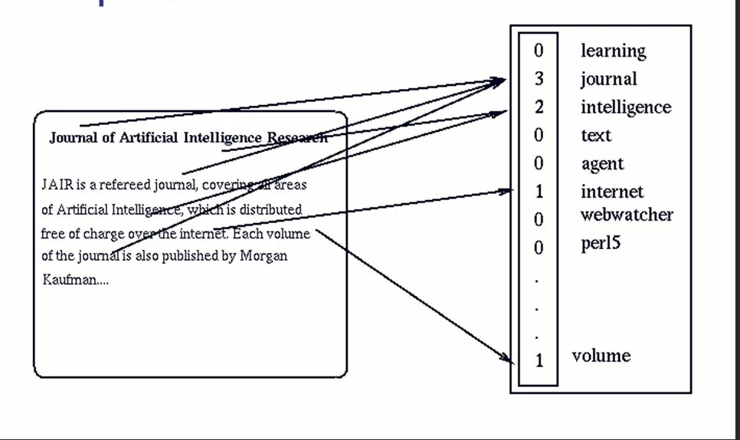
3)Bag-of-words
-A vectorized representation of text data, realised in a form of sparse matrix
-Easy to understand, uses vectors, but doesn’t take into account the positions of words

Slide 13
4)Models used
1)Lasso-regularization
-Uses OLS and takes into account a linear connection within the variables
-Includes penalty indicator to diminish the number of variables in models
2)Random Forest Regression
-Builds trees from randomly selected features
-Low variance

Slide 14
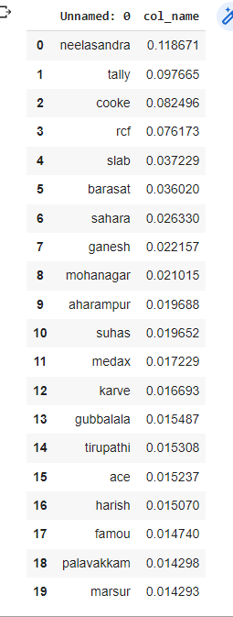
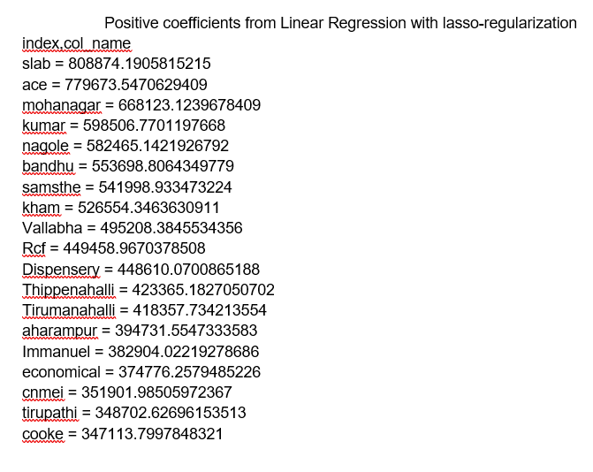
Results
The words, that affect the price the most are seen on the slide

Slide 15
Further research
The usage of LDA for building the groups and then exclusion of the groups that have locations

